Slide 1

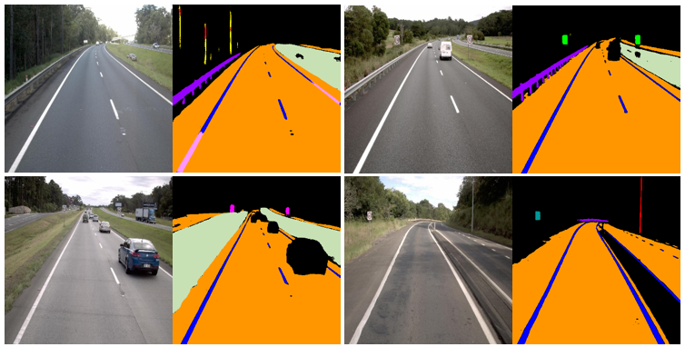
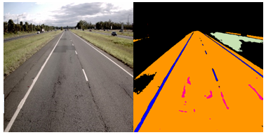
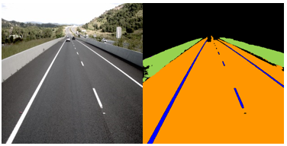
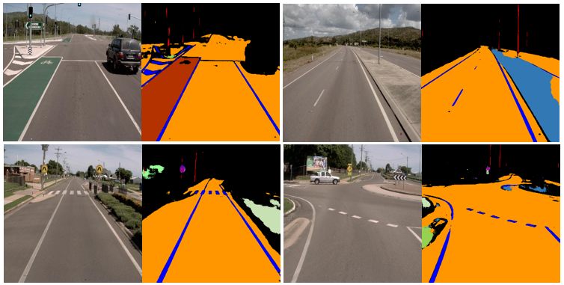
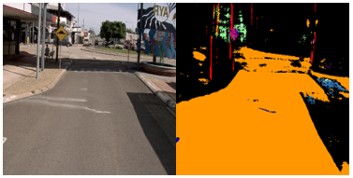
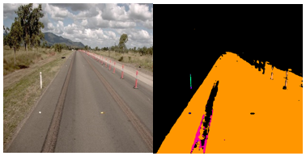
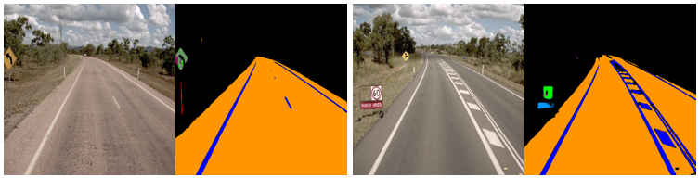
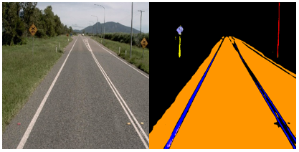
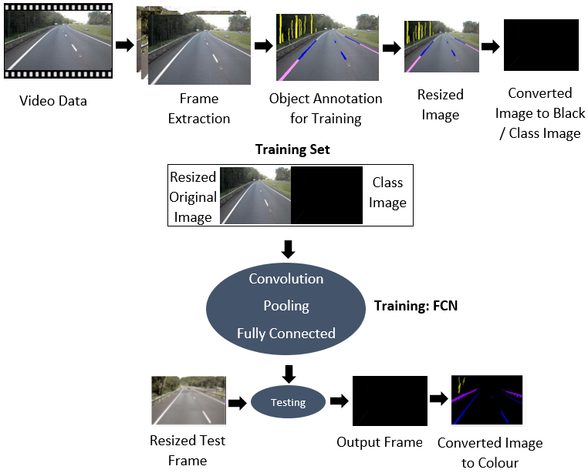
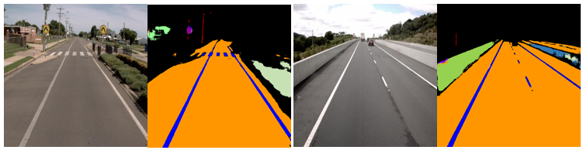
Learning and Analysis of AusRAP Attributes from Digital Video Recording for Road Safety
Pubudu Sanjeewani Thihagoda Gamage and Brijesh Verma
Center for Intelligent Systems, School of Engineering and Technology, Central Queensland University, Brisbane, Australia
p.thihagodagamage@cqu.edu.au
INTRODUCTION
Problem: With the continuous increase of the numbers of vehicles on the road, road traffic accidents now significantly contribute to injuries and become the leading cause of death [1]. Therefore, safety on the road is a significant factor directly affecting the human life. The manual systems for road safety are inefficient, very time consuming and prone to error. Automated systems face many challenges in detecting all road safety objects accurately and accurately measuring the distance between these objects [2].
What is Proposed: In this research, an automatic system to assess road safety is developed that will improve road safety and reduce fatalities on the roads. A novel technique based on Fully Convolutional Network (FCN) is proposed for automatic detection, segmentation and classification of roadside video data in order to assess important attributes pertaining to road safety.
Aim: The main aim is to learn and analyze Australian Road Assessment Program (AusRAP) attributes obtained from digital video recordings.
Proposed Technique: The proposed technique takes video frames as input, extracts features through convolutional layer and learns them to classify in fully connected layer. The proposed technique is optimized using multiple image sizes and training epochs.
Data Preparation: The 411 images obtained from roadside video data provided by the Department of Transport and Main Roads (DTMR), Queensland, Australia have been used to analyze the proposed technique.
Ground Truth
Predicted
Ground Truth
Predicted
Ground Truth
Predicted
Figure 2: System output images with lane lines, rumble strips, metal barriers, trees, poles, speed limit signs, median grass, roads, bicycle paths, signal signs, median concrete, school zone warning signs, houses and buildings, defects, concrete barriers, speed hump signs, guide posts, flexiposts, curvature signs, railway signs, and warning signs
PROPOSED METHODOLOGY
Table 1: Attribute/Object Classification Accuracy for Some Attributes using 800 × 800 Pixels and 10,000, 15,000, and 20,000 Iterations
The proposed methodology consists of two major parts.
The first part is to develop a technique which can learn and identify concerned AusRAP attributes. Therefore, this part is focused on development of an appropriate segmentation and classification technique
The second part is to evaluate the proposed technique on DTMR videos to detect all road attributes.
Attributes | Attribute based Classification Accuracy [%]
 | 10,000 iterations | 15,000 iterations | 20,000 iterations
Lane lines | 85.88 | 84.75 | 87.82
Poles | 68.55 | 94.97 | 91.19
100 signs | 75.00 | 78.57 | 28.57
110 signs | 93.75 | 100.00 | 100.00
60 signs | 0.00 | 12.50 | 25.00
Metal barriers | 84.44 | 82.22 | 88.89
Trees | 23.91 | 45.65 | 52.17
Rumble strips | 30.77 | 46.15 | 7.69
Roads | 89.00 | 93.78 | 93.30
Concrete barriers | 40.00 | 70.00 | 75.00
Curvature signs | 100.00 | 100.00 | 100.00
Guideposts | 0.00 | 0.00 | 6.25
Defects | 0.00 | 4.44 | 4.44
Warning signs | 100.00 | 100.00 | 100.00
Median concrete | 66.67 | 100.00 | 66.67
Bicycle paths | 100.00 | 100.00 | 100.00
Flexiposts | 0.00 | 16.67 | 50.00
Median grass | 21.43 | 78.57 | 92.86
DISCUSSION & CONCLUSION
The experimental results show promising prediction accuracy for many AusRAP attributes even though some attributes classified as unlabeled.
We have noted that some areas where the proposed approach struggles are with lane lines and pedestrian crossings. Figure 3 presents an example, where the approach is conflicted on whether the pedestrian crossings are lane lines (blue) or pedestrian crossings (green) and concrete barriers are median concrete (blue) or concrete barriers (green).
We expect that accuracy of other attributes will increase as we get the balanced data for training. Moreover, it was seen that the pixel size of the input images and the number of iterations used to train the proposed model have a big influence on the majority prediction counts.
In our future work, we will extend samples for attributes with low accuracy and create a balanced training data and further investigate the selection of number of iterations/epochs, input image pixel sizes and convolutional parameters to train our model.
Figure 3: Pedestrian crossings, and concrete barriers
Figure 1: Framework of the proposed approach
EXPERIMENTS & RESULTS
We have implemented the proposed approach shown in Figure 1 and conducted preliminary experiments with a number of AusRAP attributes on datasets with 224 × 224 pixels, 400 × 400 pixels and 800 × 800 pixels image sizes for 10, 000, 15,000 and 20, 000 iterations.
Results of the detection of the concerned AusRAP attributes are provided in Figure 2. Each original video frame is followed with the classifications made by the proposed approach.
Following the examples with results, we provide empirical evidence of the classification accuracy of the proposed approach.
Pixelwise and object wise accuracies have been calculated for each attribute.
ACKNOWLEDGEMENT
This research was supported under Australian Research Council's Linkage Projects funding scheme (project number LP170101255).
REFERENCES
[1] WHO. “Road traffic injuries.” who.int. https://www.who.int/news-room/fact-sheets/detail/road-traffic-injuries. (accessed Feb. 25, 2019).
[2] Z. Jan, B. Verma, J. Affum, S. Atabak, and L. Moir, “A convolutional neural network based deep learning technique for identifying road attributes,” in Proc. International Conf. Image and Vision Computing (IVCNZ), Auckland, New Zealand, Nov. 19-21, 2018.

